Slide 1


Capstone Project Shop for home JAVA &GCP C1 GROUP-2
Mentor: Parth Shukla sir
Presented By (Batch C1 Group2)
Ruchitha
Pavan kumar Pathivada
Dudekula Sameer
Swaraj Mohan Patil
Sai Prasanna Jakkula

Slide 2
PROBLEM STATEMENT
ShopForHome is a popular Store in the market for shopping the home décor stuff.
Due to Covid 19 all the offline shopping stopped.
The store wants to move to the online platforms and wants their own web application.
There are 2 users on the application: - User, Admin

Slide 3
USER STORIES
As a user I should be able to login, Logout and Register into the application.
As a user I should be able to see the products in different categories.
As a user I should be able to sort the products.
As a user I should be able to add the products into the shopping cart.
As a user I should be able to increase or decrease the quantity added in the cart.
As a user I should be able to add “n” number of products in the cart.
As a user I should be able to get the Wishlist option where I can add those products which I want but don’t want to order now.
As a user I should get different discount coupons

Slide 4
ADMIN STORIES
As an Admin I should be able to login, Logout and Register into the application.
As an Admin I should be able to perform CRUD on Users.
As an Admin I should be able to Perform CRUD on the products.
As an Admin I should be able to get bulk upload option to upload a csv for products details.
As an Admin I should be able to get the stocks.
As an Admin I should be able to mail if any stock is less than 10. As an Admin I should be able to get the sales report of a specific duration.
As an Admin I should be able to set the discount coupons for the specific set of users.

Slide 5
SOFTWARE REQUIREMENTS
Technologies :
Angular
Java spring Boot
MySQL
Languages:
Typescript
Java
SQL
HTML
CSS
Operating System:
Windows 7/8/10/11
Linux Distros
MacOs X or Late

Slide 6
Hardware Requirements
Processor : Intel or AMD dual core x86 processor
RAM : 4GB or Above
Operating System: 500MB of free disk space or more

Slide 7
SPRINT 1 OBJECTIVES
1.Create git repository
2.Create database schema (all tables along with their relationships)
3.Create entities in Spring
4.Create Microservice based structure
5.CRUD on User and Products
6.Create an eCommerce Template in Angular (Static only) to hold images and products lists
7.Develop Search Functionality in Angular
8.Bulk upload implementation

Slide 8
SPRINT 2 OBJECTIVES
1.Cart option
2.Stock and Sales reports
3.Create Data Transfer objects
4.Create repository
5Create Service layer logic
6.Create Controller to direct rest api
7.Create Discount Microservice
8.Create user data script for deployment on VMs
9.Deploy application on VMs

Slide 9
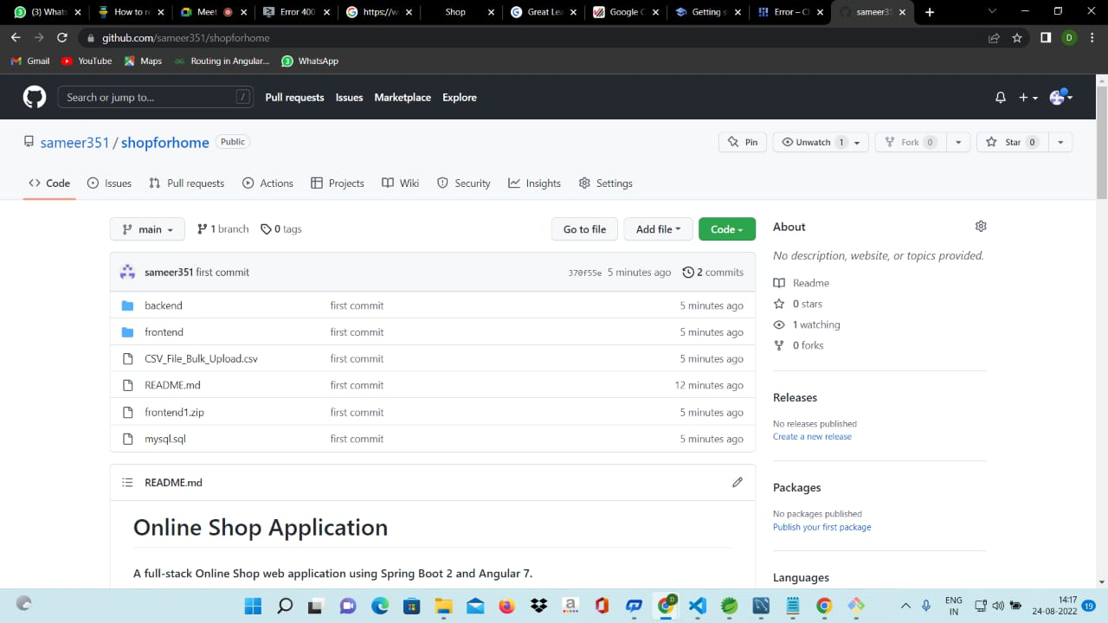
CREATE GIT REPOSITORY

Slide 10
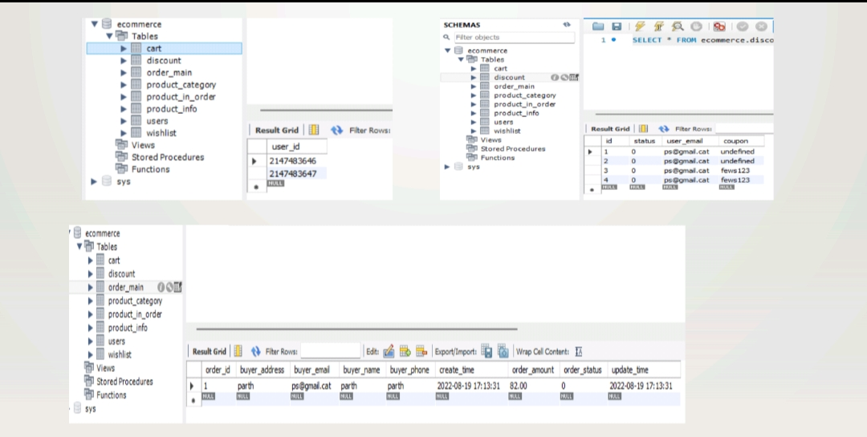
DATABASE SCHEME

Slide 11
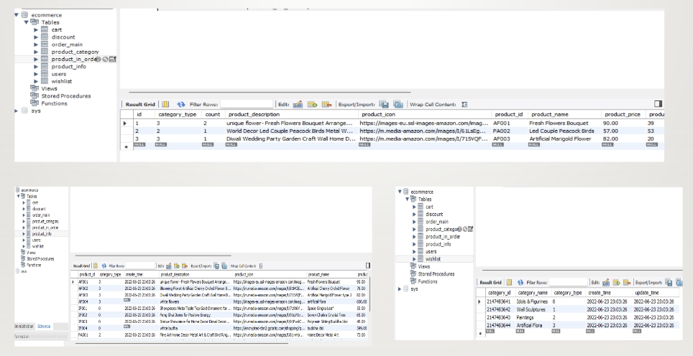
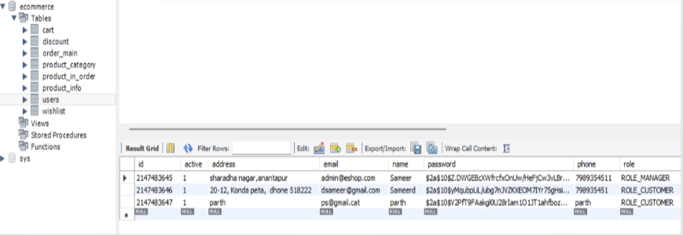

Slide 12
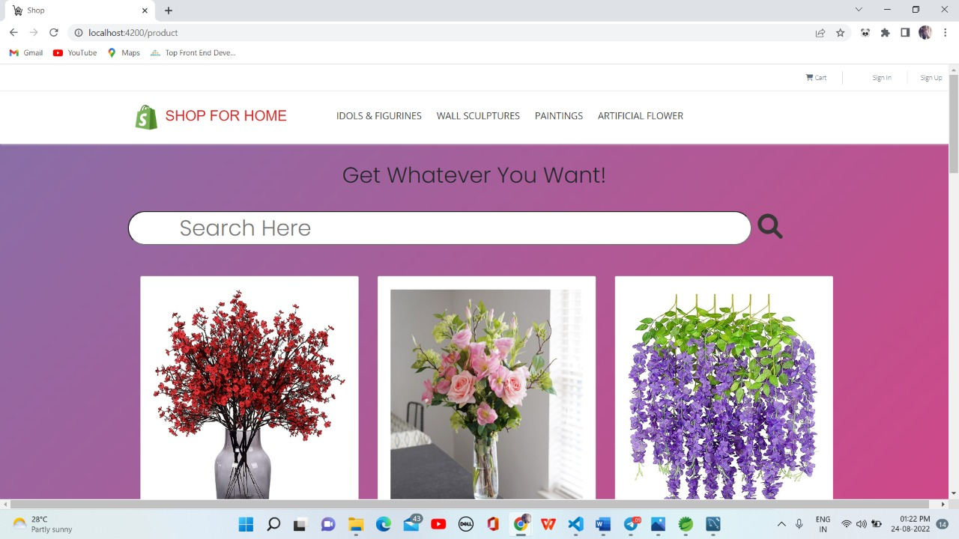
HOME PAGE

Slide 13
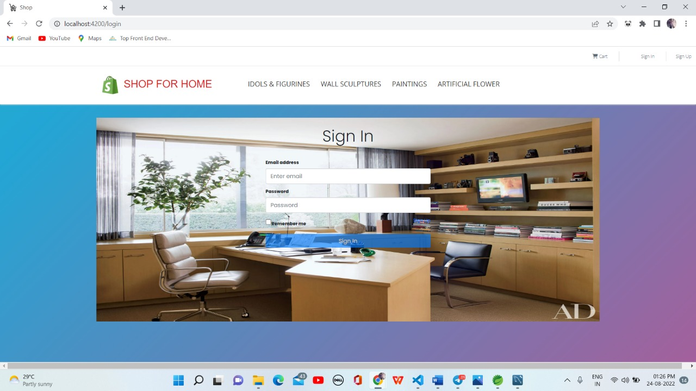
SIGN IN

Slide 14
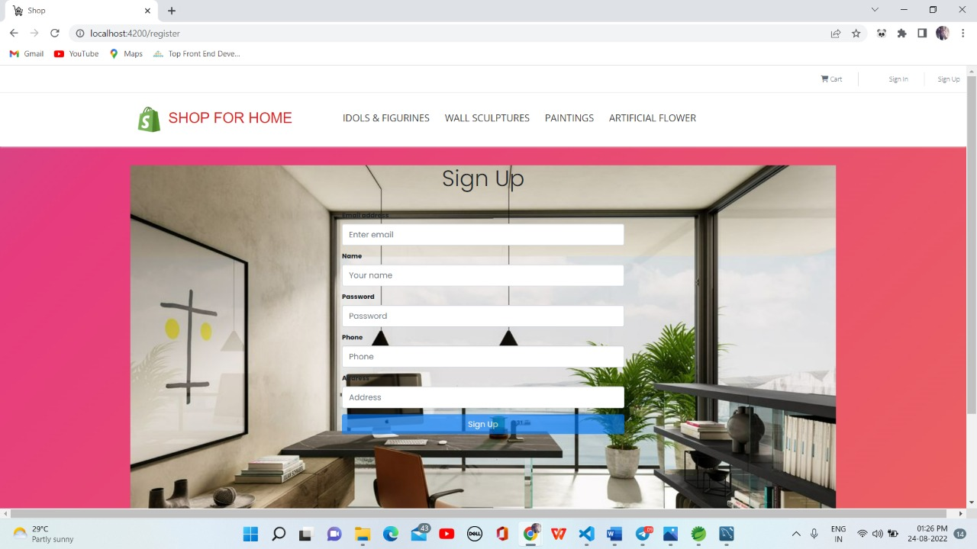
SIGN UP

Slide 15
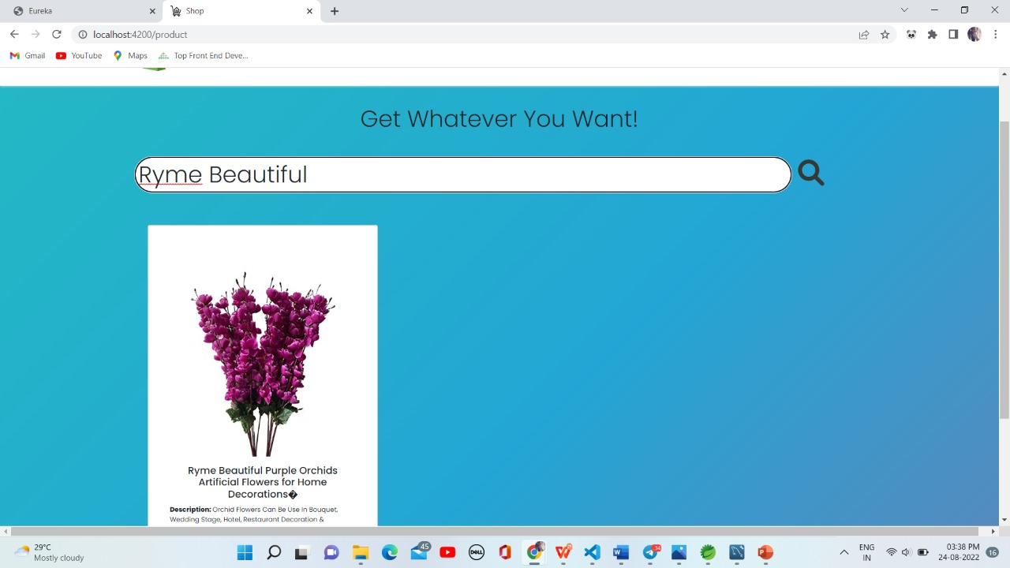
PRODUCT SEARCH PAGE

Slide 16
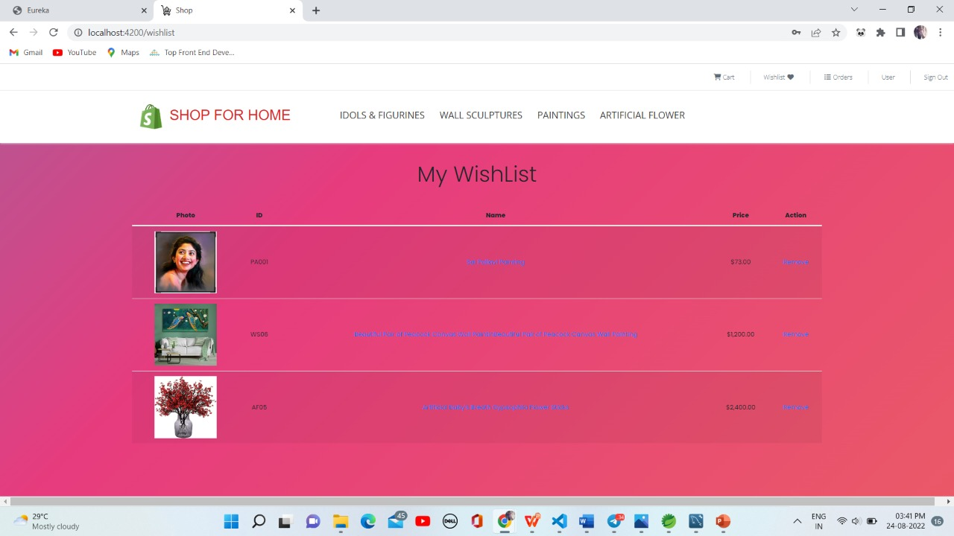
WISHLIST

Slide 17
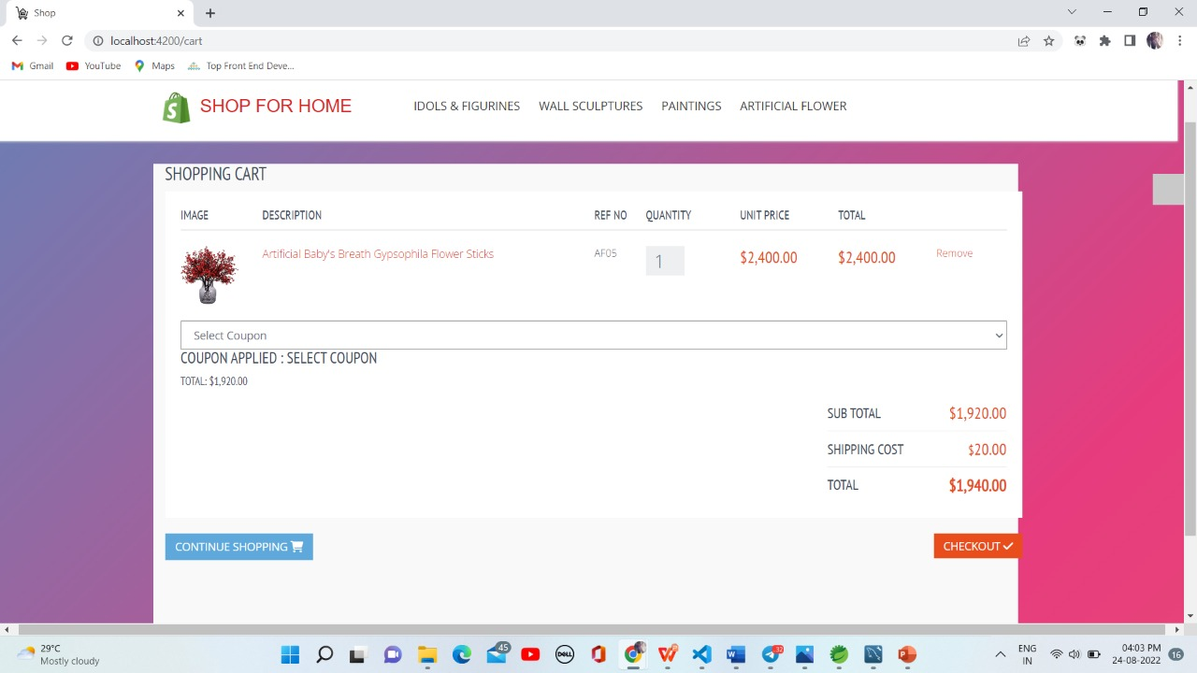
DISCOUNT

Slide 18
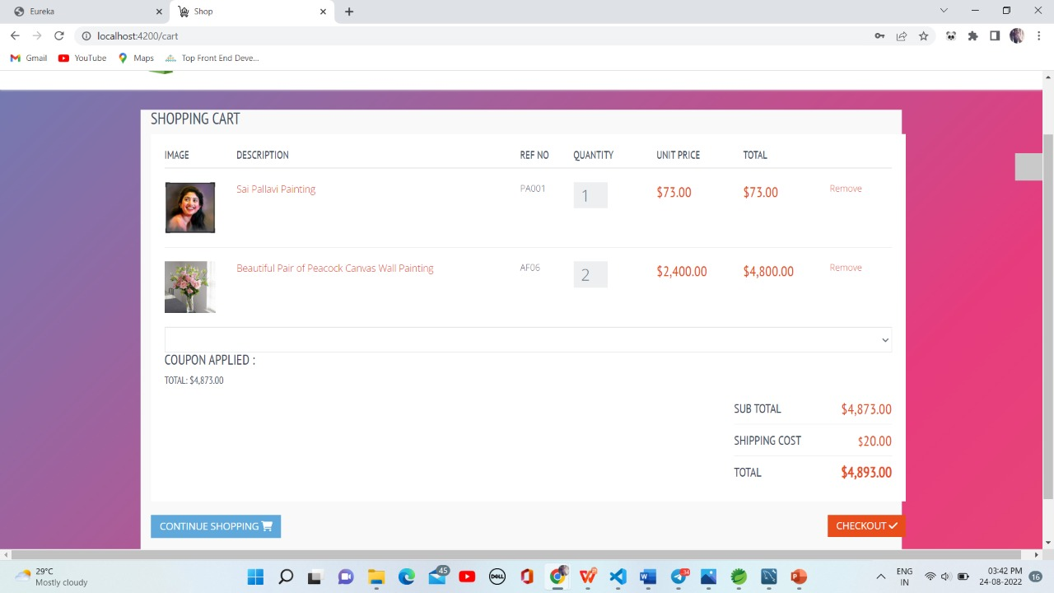
ADD TO CART

Slide 19
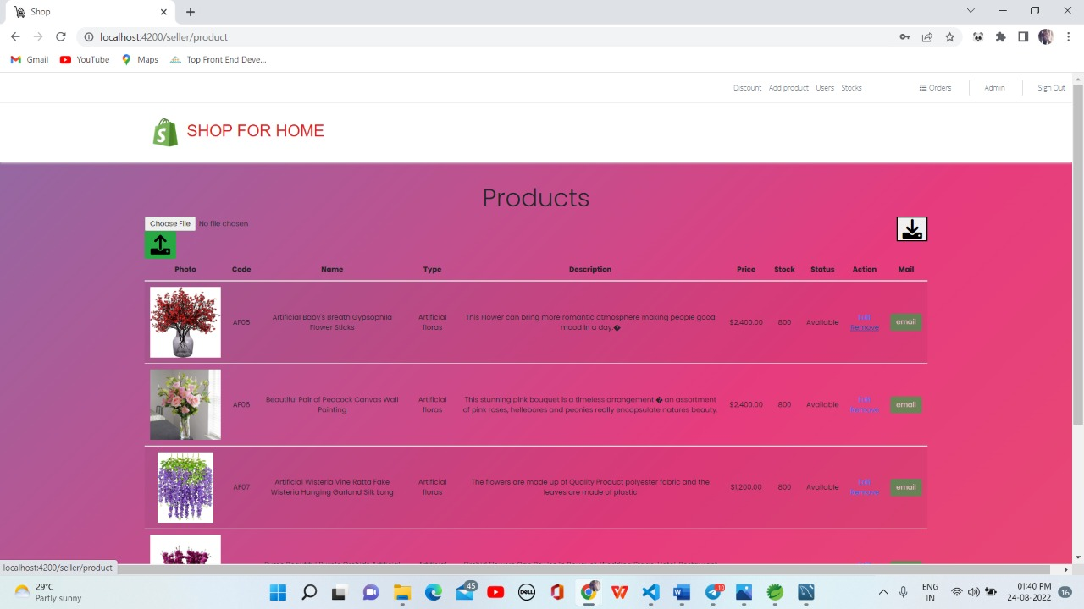
ADMIN FUNCTIONALITY: HOMEPAGE

Slide 20
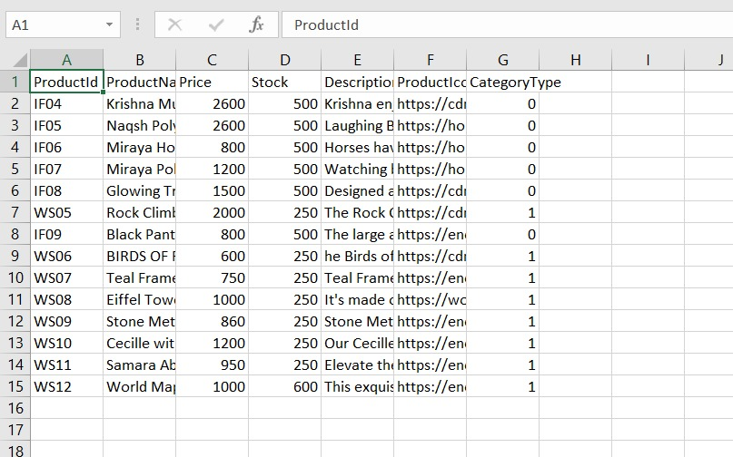
BULK UPLOAD

Slide 21
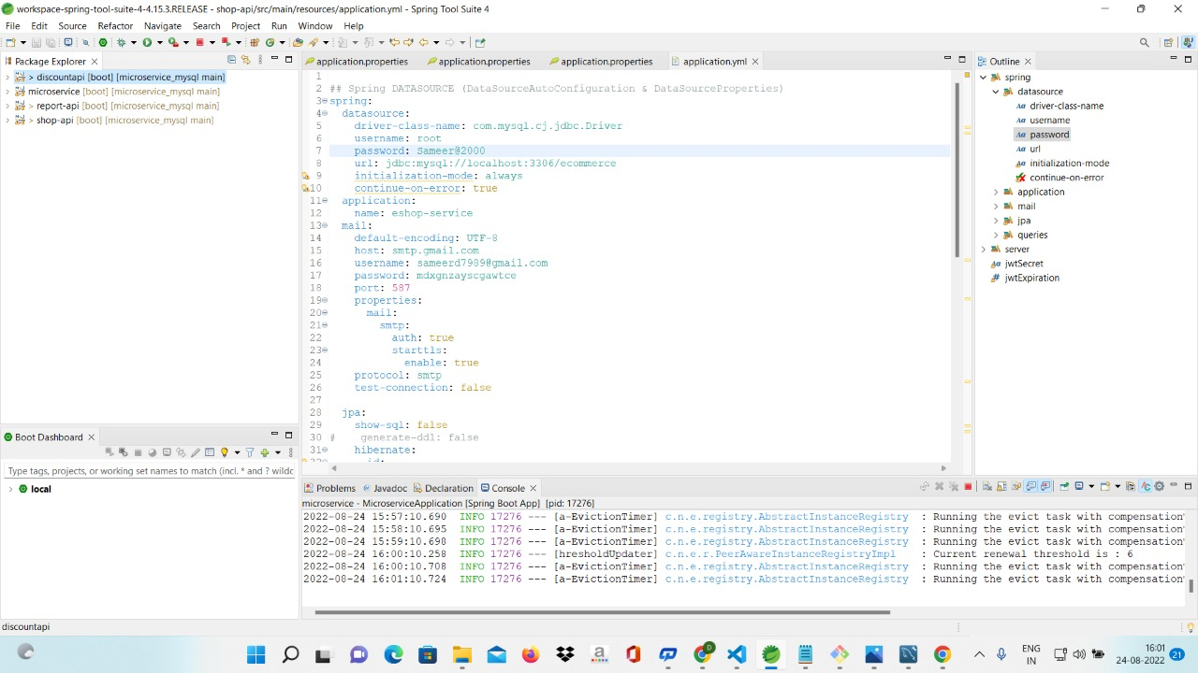
BACKEND

Slide 22
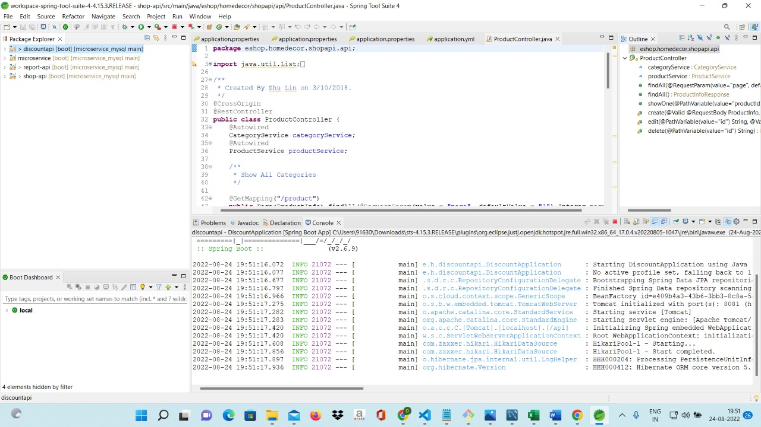
SHOP FOR HOME DISCOUNT API

Slide 23
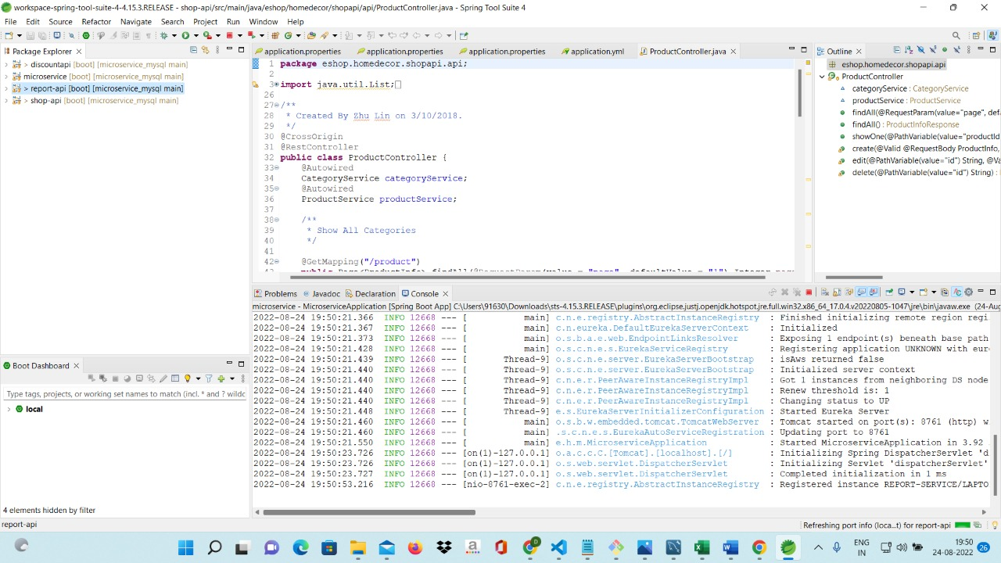
SHOP FOR HOME REPORT API

Slide 24
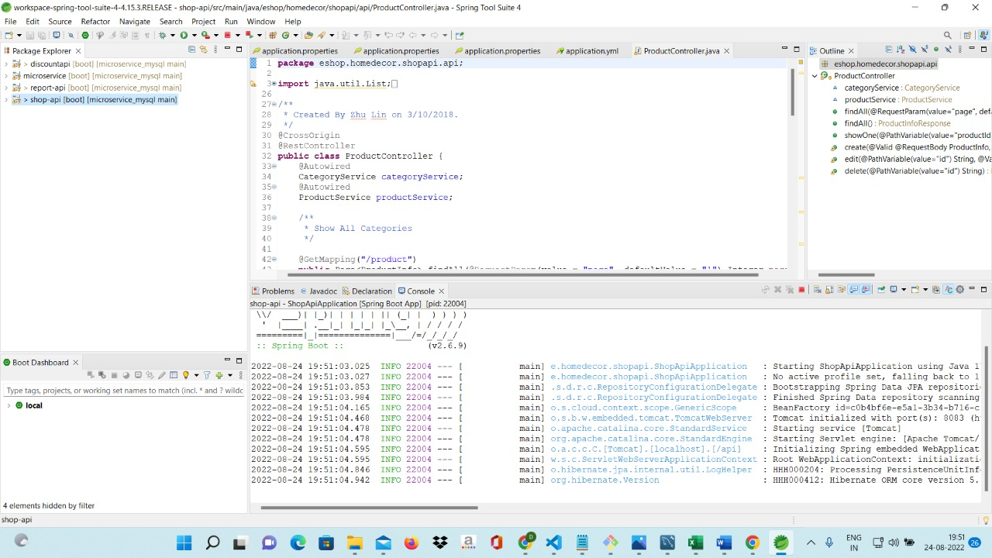
SHOP FOR HOME SHOP API

Slide 25
CLOUD DEPLOYMENT
gcloud config set project greatlear-1661238846276
echo $GOOGLE_CLOUD_PROJECT
gcloud config set compute/zone us-west2-a
git clone http://github.com/sameer351/shopforhome.git
ls
cd shopforhome
cd frontend
node –v
npm –v
npm install -g @angular/cli
npm install -g typescript
nvm install 16.10
npm install
ng serve

Slide 26
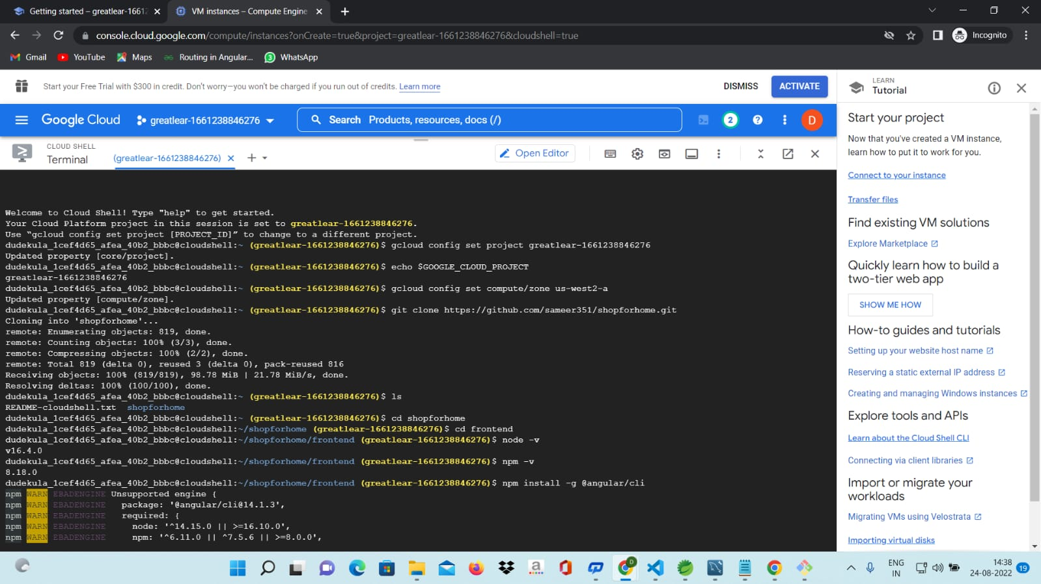

Slide 27
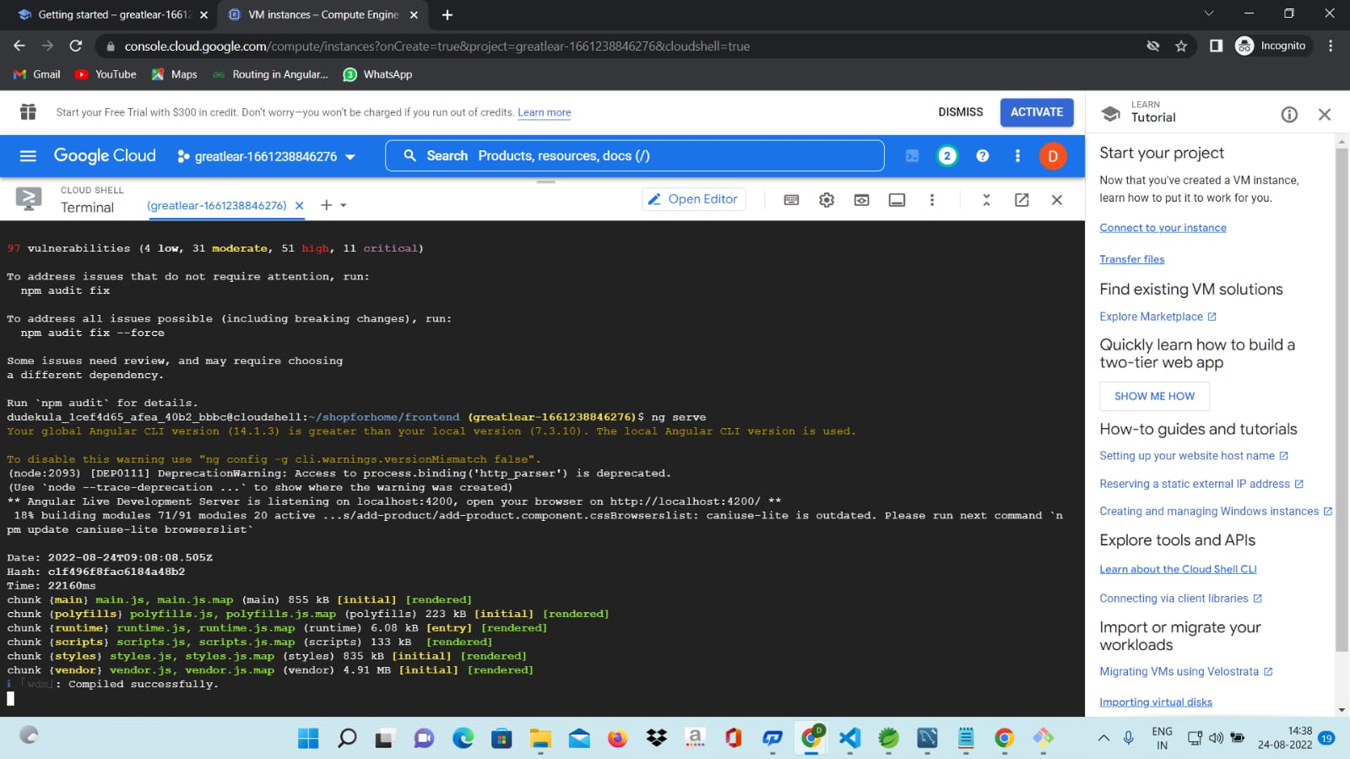

Slide 28
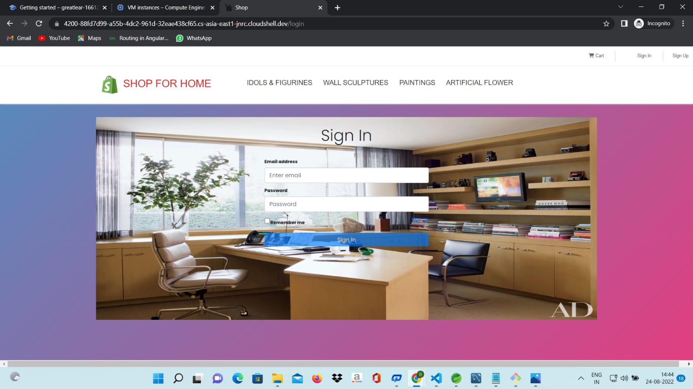
SHOP FOR HOME WEBSITE USING CLOUD

Slide 29
THANK YOU

